Slide 1
Deep Interest Evolution Network for Click-Through Rate Prediction
Speaker：Liqi Yang
Date: 2020/03/25

Slide 2
Problem && Motivation
Related work
Base model
Deep interest evolution model
Experiments
Summary

Slide 3
1. Problem && Motivation
Problem
Estimate the probability of a user clicking on the item
Specifically, categories of feature:
User Profile : gender, age and so on
User Behavior : the list of user visited goods id
Ad : ad_id , shop_id and so on
Context: time and so on
Motivation
Dig users’ latent interests behind behaviors instead of regarding the behavior as the interest directly
Capture the evolution of user’s interest related to the target item

Slide 4
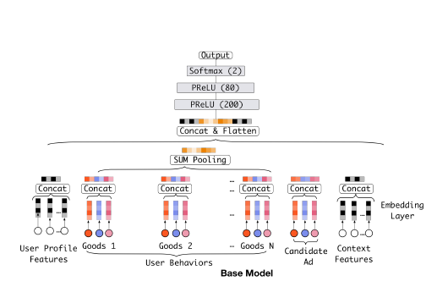
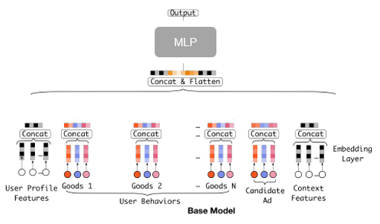

2. Related work
Deep learning on feature representation and combination
MLP
Wide & Deep (Cheng et al.2016) and deep FM (Guo et al. 2017)
PNN (Qu et al. 2016)
can not reflect the interest behind data clearly
c) DIN (Zhou et al. 2018c)
weak in capturing the dependencies between sequential behaviors
Notes:
Wide & Deep , deep FM combine low-order and high-order features to improve the power of expression
PNN (Qu et al. 2016) proposes a product layer to capture interactive patterns between interfield categories
can not reflect the interest behind data clearly
c) DIN (Zhou et al. 2018c) introduces the mechanism of attention to activate the historical behaviors w.r.t. given target item locally, and captures the diversity characteristic of user interests successfully.
weak in capturing the dependencies between sequential behaviors

Slide 5
2. Related work
Sequence-dependent approaches in RS
Utilize user-item interactions over time
TDSSM (Song, Elkahky, and He 2016) long-term and short-term user interests
DREAM (Yut al. 2016) dynamic representation of user-item purchase history
ATRank (Zhou et al. 2018a) model heterogeneous behaviors
And so on
Shortcoming:
lack special supervision for interest representation
auxiliary loss
DARNN (Ren et al.2018) click-level sequential prediction
Rendle et al. 2009;Hidasi and Karatzoglou 2017) ranking information

Slide 6
2. Related work
Sequence-independent approaches in RS
Utilize user-item interactions over time
TDSSM (Song, Elkahky, and He 2016) long-term and short-term user interests
DREAM (Yut al. 2016) dynamic representation of user-item purchase history
ATRank (Zhou et al. 2018a) model heterogeneous behaviors
And so on
Shortcoming :
lack special supervision for interest representation
interest evolving : drifting
AUGRU
DMN+ (Xiong, Merity, and Socher 2016) attention based GRU (AGRU)
Notes:
Interest evolution: 对任意的target item。 这些RNN based 的方法， 处理的是相邻的behaviors之间的依赖关系，且Interest的演变过程是一样的。但是并不是所有用户的行为都严格依赖于每个相邻的行为。每个用户都有不同的兴趣，每个兴趣都有自己的发展轨迹。

Slide 7
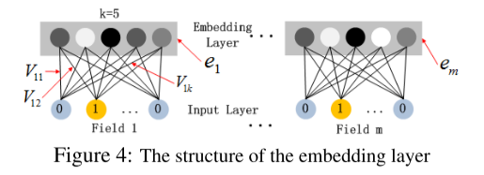
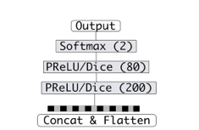



3. Base model
Feature embedding
User Profile, User Behavior, Ad, Context: one-hot
User Behavior:
MLP for final prediction
Loss function
where

Slide 8
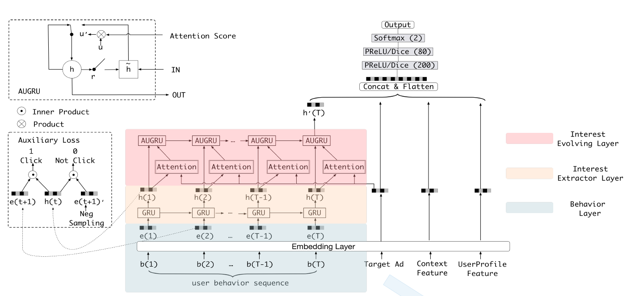
4. Deep Interest Evolution Network

Slide 9
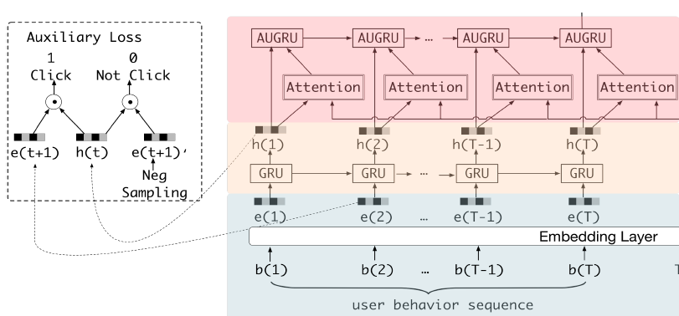
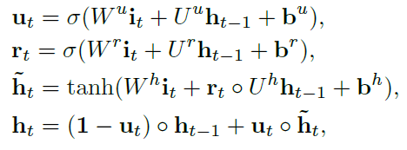
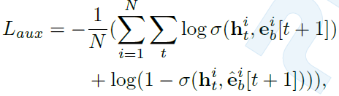


4. Deep Interest Evolution Network
Interest Extractor Layer
auxiliary loss
Next-click item prediction
Negative sample sequence
Advantages:
represent interest expressively
reduces the difficulty of back propagation
gives more semantic information for the learning of embedding layer

Slide 10

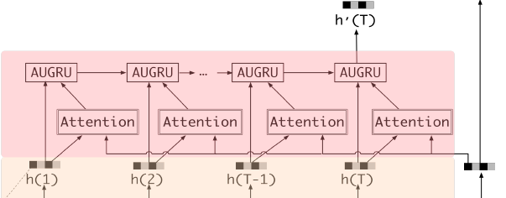
4. Deep Interest Evolution Network
Interest Evolving Layer
local activation: attention mechanism
Notes:
Intensify relative interest’s effect, and weaken the disturbance from interest drifting

Slide 11



4. Deep Interest Evolution Network
Interest Evolving Layer
GRU with attentional input (AIGRU)
Attention based GRU(AGRU)
GRU with attentional update gate (AUGRU)
Advantages:
keep the importance of each dimension
less related interest make less effects on the hidden state.
Notes:
Intensify relative interest’s effect, and weaken the disturbance from interest drifting

Slide 12
5. Experiments
Datasets
Amazon dataset: Books and Electronics
reviews as behaviors, and predict whether user will write reviews
Industrial Dataset : online display advertising system
Compared methods
BaseModel
Wide&Deep
PNN (Qu et al. 2016)
DIN (Zhou et al. 2018c)
Two layer GRU attention

Slide 13
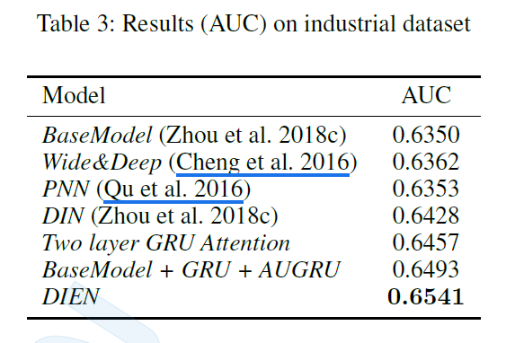
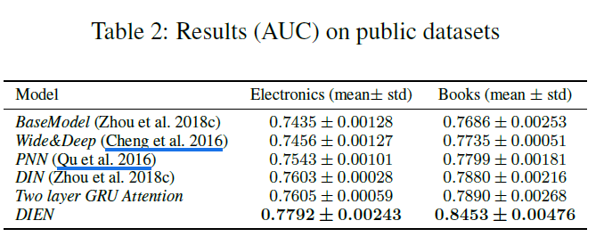
5. Experiments
Results

Slide 14
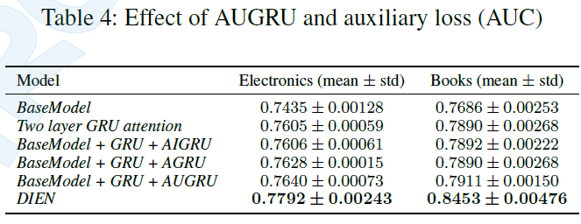
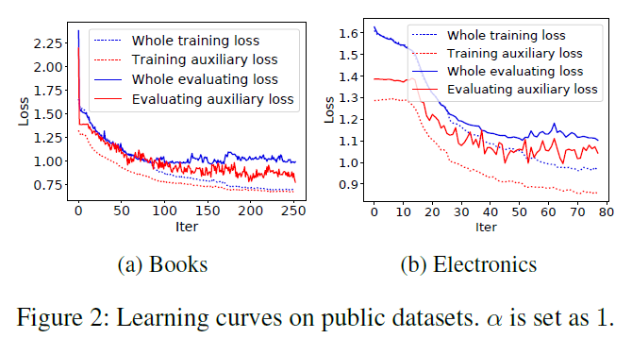
5. Experiments
Effect of GRU with attentional update gate (AUGRU)
Effect of auxiliary loss

Slide 15
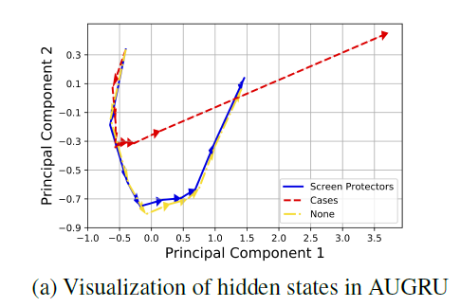
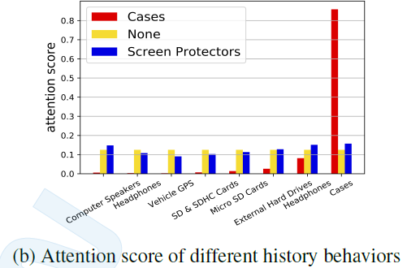
5. Experiments
Visualization of Interest Evolution
history behaviors： Computer Speakers, Headphones, Vehicle GPS, SD & SDHC Cards, Micro SD Cards, External Hard Drives, Headphones, Cases

Slide 16
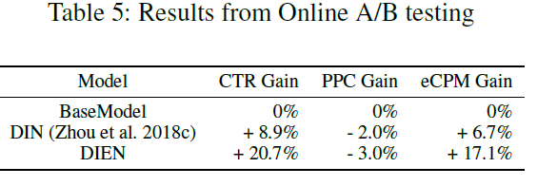
5. Experiments
Online A/B testing
pay per
click
effective cost per mille

Slide 17
6. Summary
User’s interest representation:
Learn more semantic interest representation from the user behavior sequence
Consider the interest evolution related the target item
Model:
Design specific GRU for different tasks
auxiliary loss is a common trick

Slide 18
Thanks for your listening!
Q & A

Slide 19
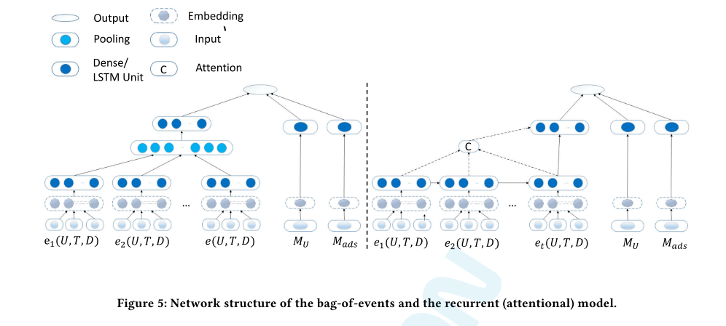
备注
Two layer GRU + attention

Slide 20
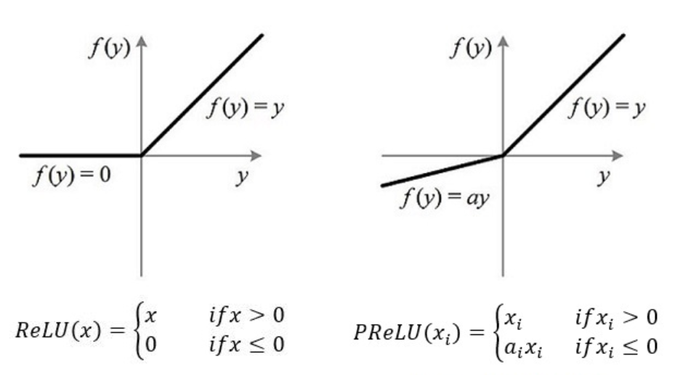
备注
PRelu
在几乎没有增加额外参数的前提下既可以提升模型的拟合能力

Slide 21
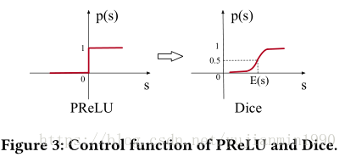
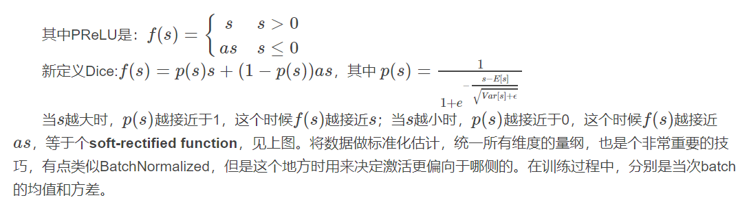

备注
Dice

Slide 22
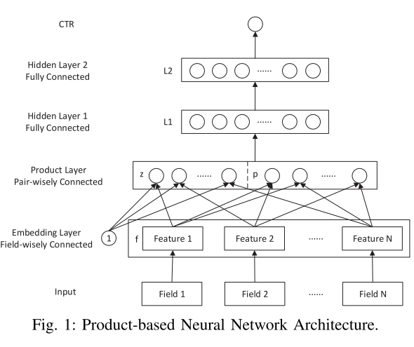
备注
PNN

Slide 23
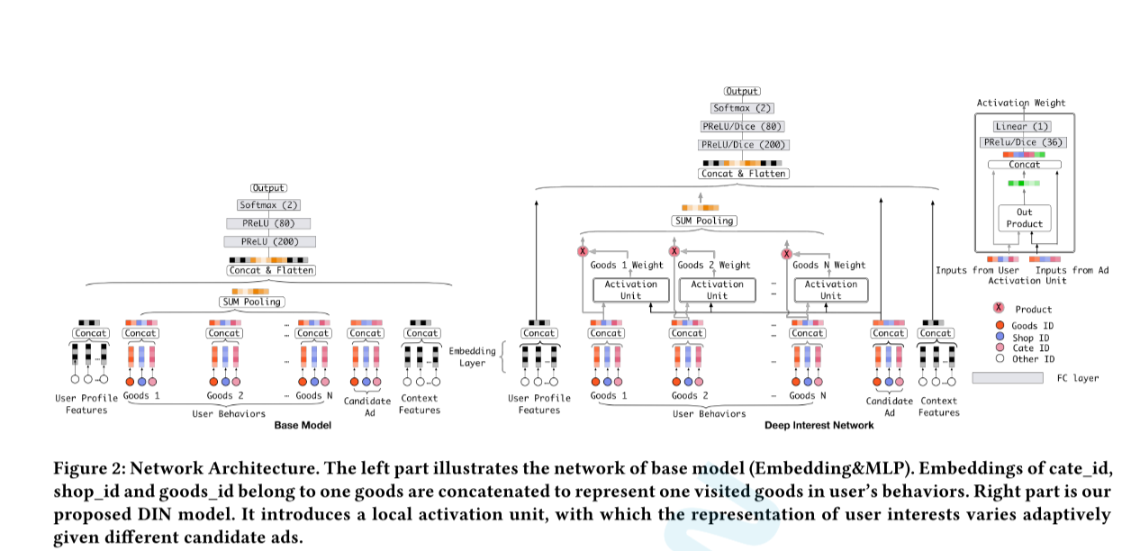
备注
DIN

Slide 24
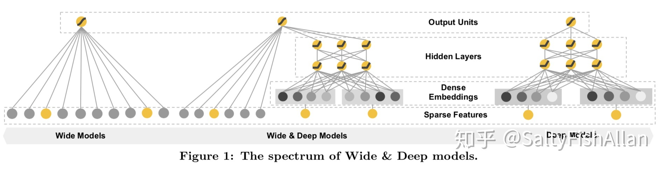
备注
Wide && deep

Slide 25
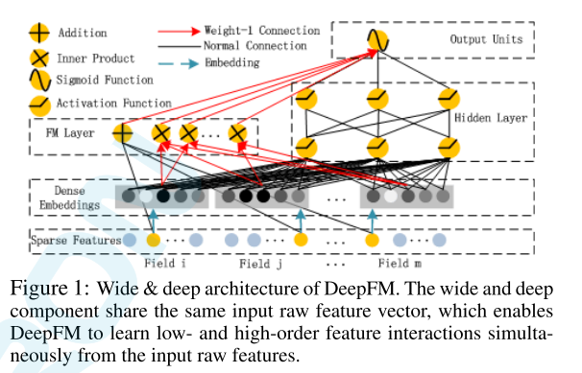
备注
deepFM

